Slide 1
RetinaNet
(Focal Loss for Dense Object Detection)
발표자 : 182605 이윤수

Slide 2
Index
Introduction
Focal Loss
RetinaNet
Experiments

Slide 3
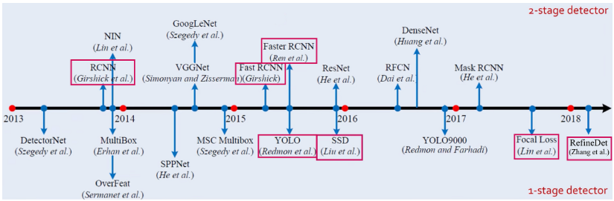
Introduction

Slide 4
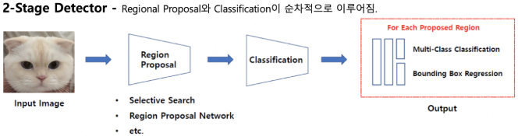
Introduction
2-Stage Detector

Slide 5
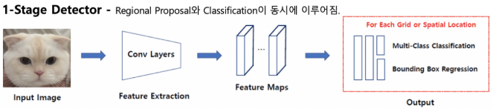
Introduction
1-Stage Detector

Slide 6
Introduction
2-Stage Detector
A classifier is applied to a sparse set of candidate object location
1-Stage Detector
Applied over a regular, dense sampling of possible object locations
=> Faster and simpler but less accuracy

Slide 7
Introduction
The extreme foreground-background class imbalance
Reshaping the standard cross entropy loss such that it down-weights the loss assigned to well–classified examples
Simple one-stage detector achieve similar accuracy

Slide 8
Introduction
2-Stage Detector(R-CNN-like)
The proposal stage(Selective Search, EdgeBoxes…) rapidly narrows down the number of candidate object locations to a small number, filtering out most background samples
Classification stage, sampling heuristics(foreground-to-background ratio (1:3), OHEM)
=> Balance between foreground and background

Slide 9
Introduction
1-Stage Detector
Ineffecient as the training procedure is still dominated by easily classified background example

Slide 10
Related Work
Classic Object Detectors
Two-stage Detectors
One-stage Detectors
Class Imbalance
Robust Estimation

Slide 11
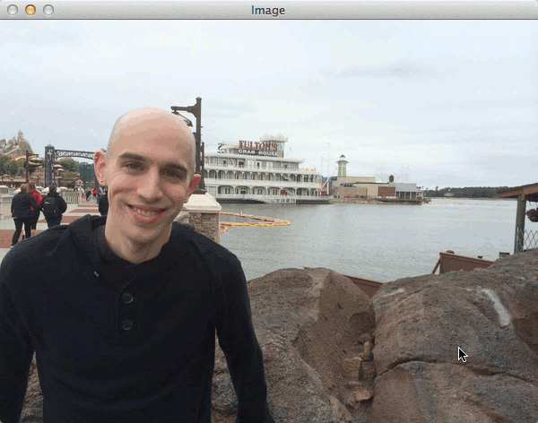
Classic Object Detectors
Sliding-window paradigm, in which a classifier is applied on a dense image grid

Slide 12
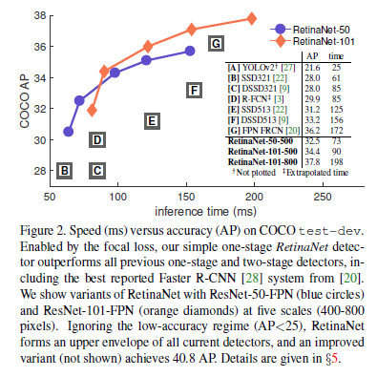
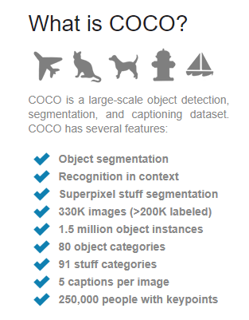
One-stage Detectors

Slide 13
Class Imbalance
This imbalance causes two problems:
training is inefficient as most locations are easy negatives that contribute no useful learning signal
2. the easy negatives can overwhelm training and lead to degenerate models.

Slide 14
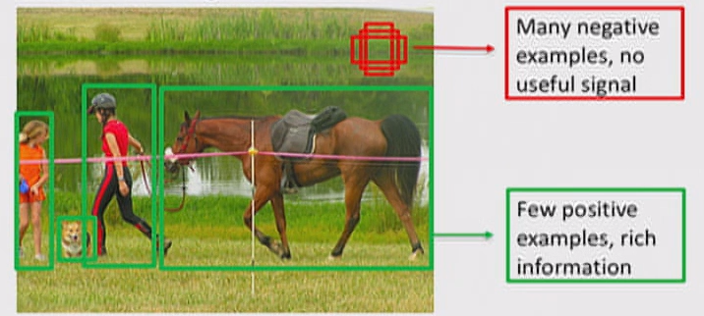
Class Imbalance

Slide 15
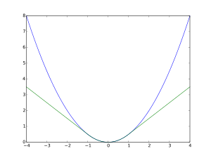
Robust Estimation
Robust loss function that reduce the contribution of outliers by down-weighting the loss of examples with large errors(hard examples)
In contrast,
Focal Loss is designed to address class imbalance by down-weighting inliers(easy example)
such that contribution to the total loss is small even if their number is large.
In other words,
It focuses training on a sparse set of hard examples.

Slide 16
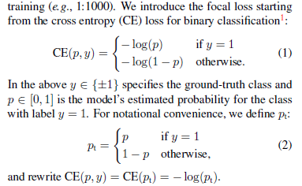
Focal Loss

Slide 17
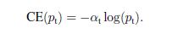
Focal Loss
Balanced Cross Entropy
A common method for addressing class imbalance is to introduce a weighting factor
=> Balances the importance of positive/negative examples

Slide 18
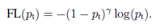
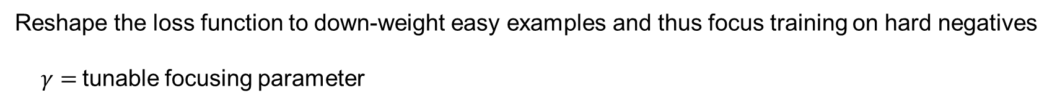
Focal Loss
Focal Loss Definition
Reshape the loss function to down-weight easy examples and thus focus training on hard negatives
$γ=$tunable focusing parameter

Slide 19
Focal Loss
Focal Loss Definition
(1) When an example is misclassified and pt is small, the modulating factor is near 1 and the loss is unaffected. As pt -> 1, the factor goes to 0 and the loss for well-classified examples is down-weighted.
(2) The focusing parameter smoothly adjusts the rate at which easy examples are down-weighted.

Slide 20
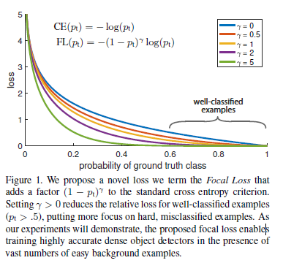
Focal Loss

Slide 21
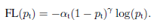
Focal Loss
Focal Loss Definition
It yields slightly improved accuracy over the non-a-balanced form.

Slide 22
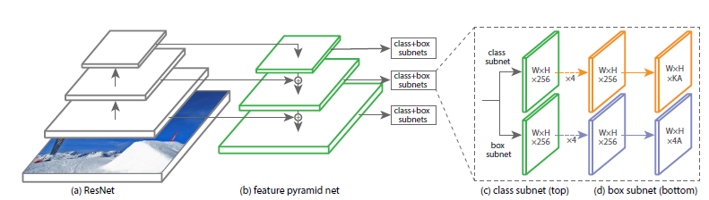
RetinaNet
RetinaNet is a single, unified network composed of a backbone network and two task-specific subnetworks.
Backbone is responsible for computing a convolutional feature map over an entire input image and is an off-the-self convolutional network.
The first subnet performs convolutional object classification on the backbone’s output.
The second subnet performs convolutional bounding box regression.

Slide 23
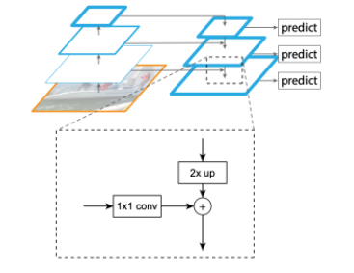
RetinaNet
Feature Pyramid Network
다양한 크기의 물체를 탐지하기 위해
신경망을 통과하면서 단계별로 피쳐 맵들을 생성합니다. 그리고 가장 상위 레이어에서 부터 거꾸로 내려오면서 피쳐를 합쳐준 뒤, Object Detection을 진행합니다.

Slide 24
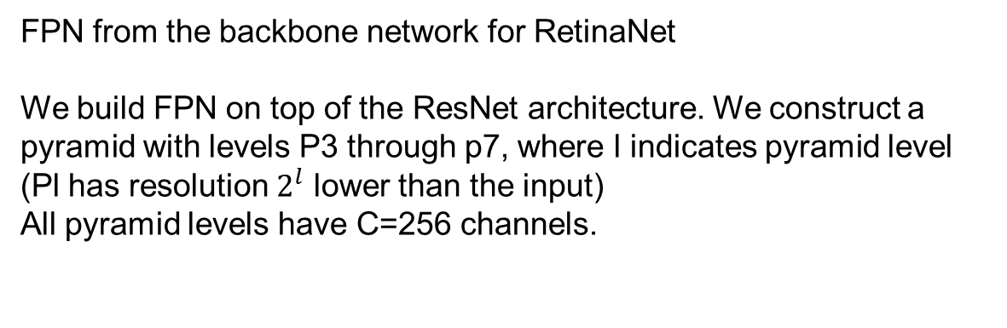
RetinaNet
Feature Pyramid Network
FPN from the backbone network for RetinaNet
We build FPN on top of the ResNet architecture. We construct a pyramid with levels P3 through p7, where l indicates pyramid level (Pl has resolution $2^{l}$ lower than the input) All pyramid levels have C=256 channels.

Slide 25
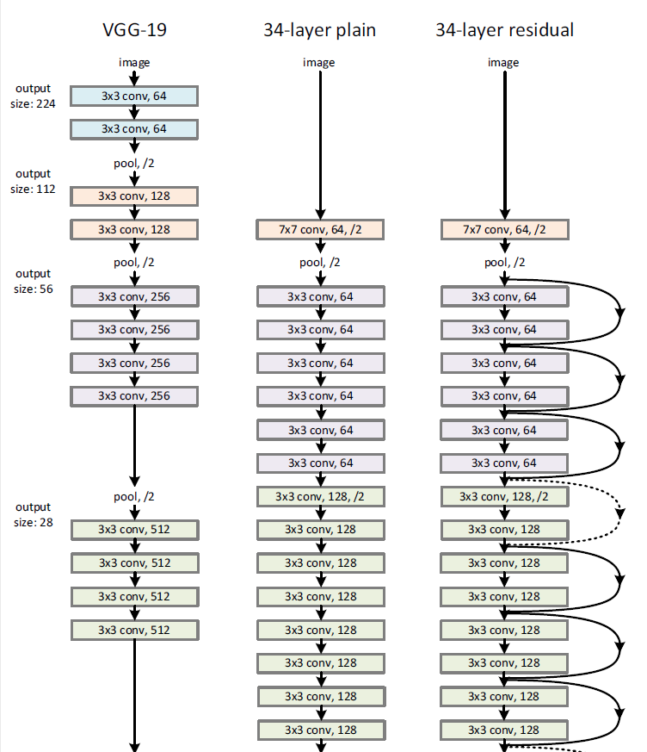
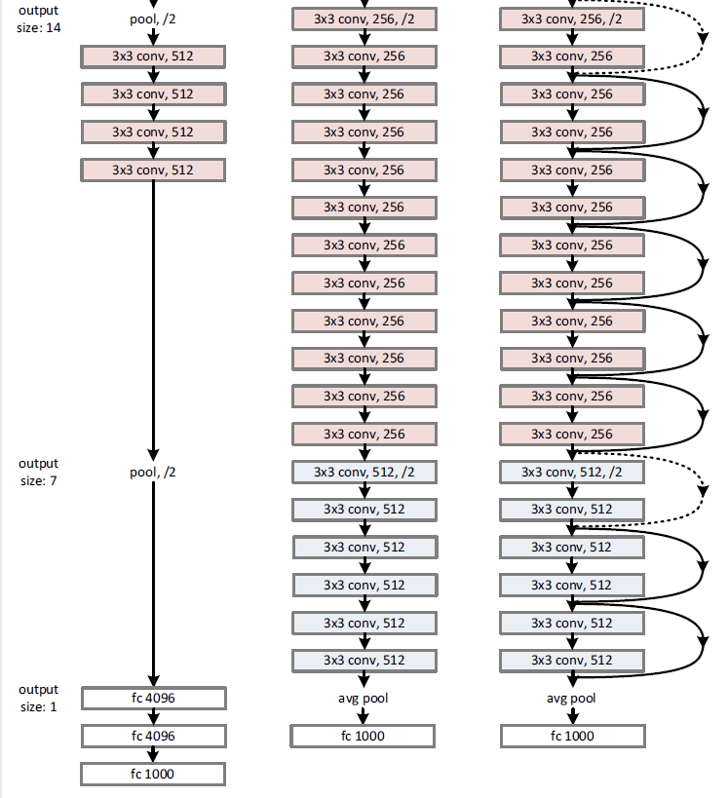
RetinaNet

Slide 26
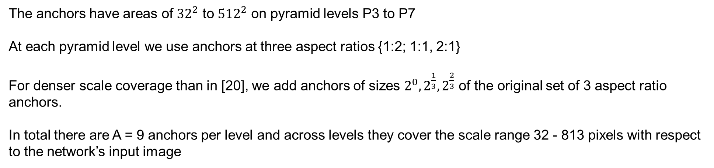
RetinaNet
Anchors
The anchors have areas of ${32}^{2}$ to ${512}^{2}$ on pyramid levels P3 to P7
At each pyramid level we use anchors at three aspect ratios {1:2; 1:1, 2:1}
For denser scale coverage than in [20], we add anchors of sizes $2^{0},2^{\frac{1}{3}},2^{\frac{2}{3}}$ of the original set of 3 aspect ratio anchors.
In total there are A = 9 anchors per level and across levels they cover the scale range 32 - 813 pixels with respect to the network’s input image

Slide 27
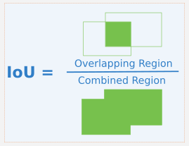
RetinaNet
Anchors
Specifically, anchors are assigned to ground-truth object boxes using an intersection-over-union (IoU) threshold of 0.5 and to background if their IoU is in [0, 0.4).
If an anchor is unassigned, which may happen with overlap in [0.4, 0.5), it is ignored during training.

Slide 28
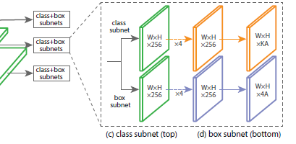
RetinaNet
Classification Subnet
The classification subnet predicts the probability of object presence at each spatial position for each of the A anchors and K object classes.
This subnet is a small FCN attached to each FPN level.
We use C = 256 and A = 9 in most experiments.

Slide 29
RetinaNet
Box Subnet
Attach another small FCN to each pyramid Level for the purpose of regressing the offset from each anchor box to a nearby ground-truth object
For each of the A anchors per spatial location, these 4 outputs predict the relative offset between the anchor and the ground truth box

Slide 30
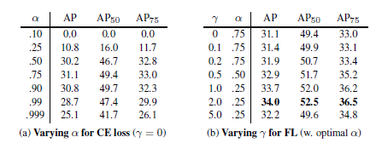
RetinaNet
Training
γ = 2, α = 0.25

Slide 31
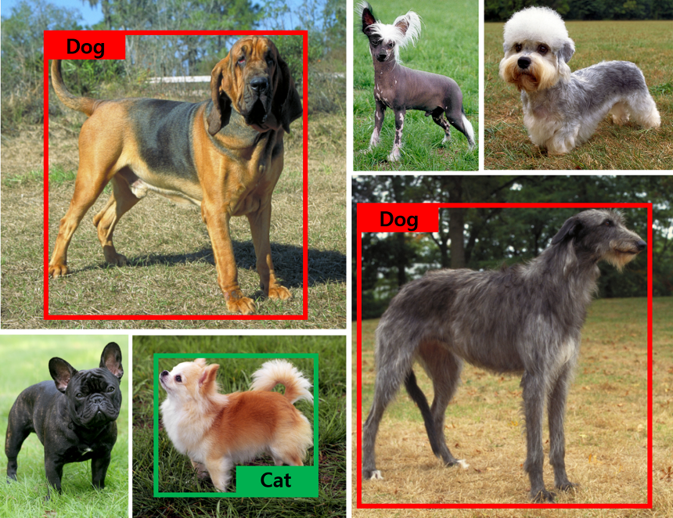
RetinaNet

Slide 32
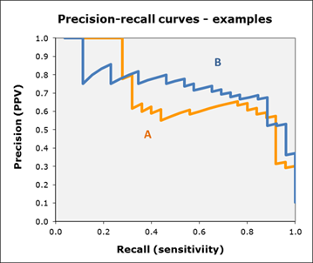
RetinaNet
Recall(검출율) : 객체(object) 로서 검출(detected) 된 것
Precision : 인식된(혹은 검출된) 객체에 대한 분류(classification)의 정확도
Recall 과 Precision은 반비례 하는 경향
Curve 아래의 면적 넓이의 값을 AP(average precision)

Slide 33
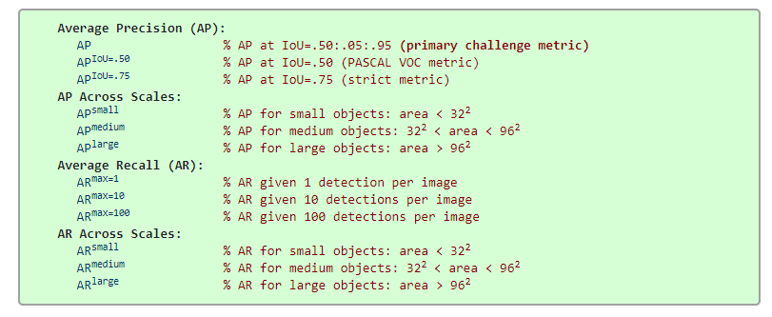
RetinaNet

Slide 34
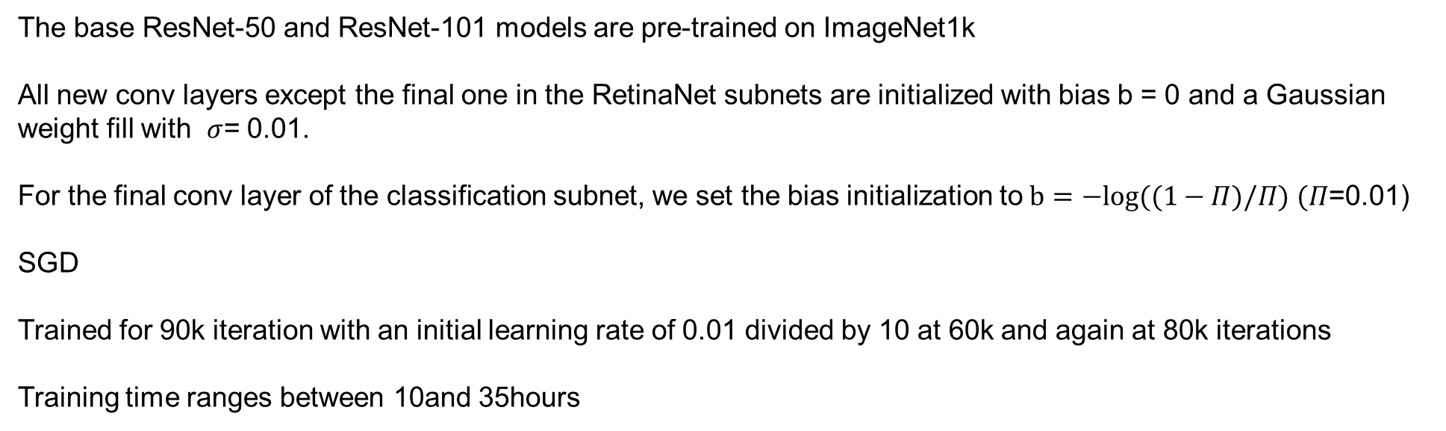
RetinaNet
Training
The base ResNet-50 and ResNet-101 models are pre-trained on ImageNet1k
All new conv layers except the final one in the RetinaNet subnets are initialized with bias b = 0 and a Gaussian weight fill with $σ$= 0.01.
For the final conv layer of the classification subnet, we set the bias initialization to$b=−log((1−Π)/Π)$ $(Π$=0.01)
SGD
Trained for 90k iteration with an initial learning rate of 0.01 divided by 10 at 60k and again at 80k iterations
Training time ranges between 10and 35hours

Slide 35
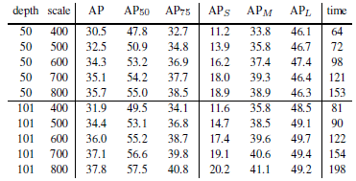
RetinaNet

Slide 36
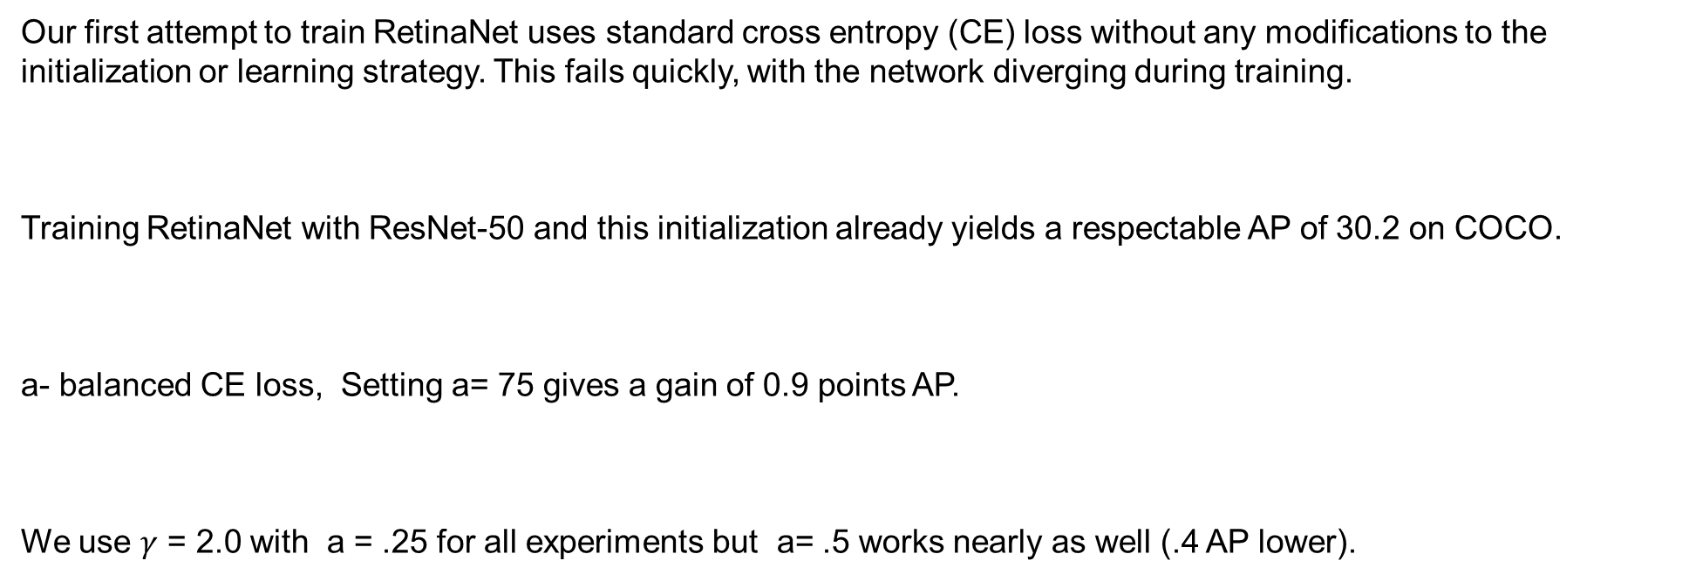
RetinaNet
Experiments
Our first attempt to train RetinaNet uses standard cross entropy (CE) loss without any modifications to the initialization or learning strategy. This fails quickly, with the network diverging during training.
Training RetinaNet with ResNet-50 and this initialization already yields a respectable AP of 30.2 on COCO.
a- balanced CE loss, Setting a= 75 gives a gain of 0.9 points AP.
We use $γ$ = 2.0 with a = .25 for all experiments but a= .5 works nearly as well (.4 AP lower).

Slide 37
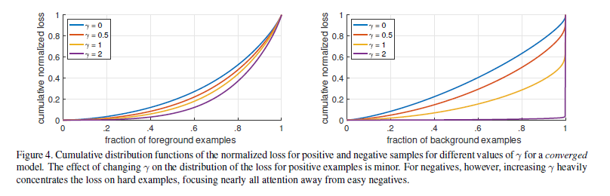
RetinaNet
Experiments
FL can effectively discount the effect of easy negatives, focusing all attention on the hard negative examples.

Slide 38
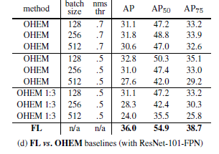
RetinaNet
Experiments
unlike FL, OHEM completely discards easy examples.

Slide 39
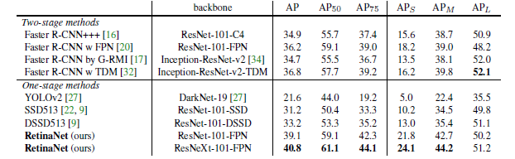
RetinaNet

Slide 40
Q & A

